Slide 1
TEMPERATURE AND HUMIDITY CONTROL SYSTEM
Submitted by-
Mumtaz Uddin (0827IT151066)
Shreya Khandelwal (0827IT151108)
Yashovardhan Singh (0827IT151124)

Slide 2
OVERVIEW
The DHT11 Temperature & Humidity Sensor features a temperature & humidity sensor complex with calibrated digital signal output. By using the exclusive digital-signal-acquisition technique and temperature & humidity sensing technology, it ensures high reliability and excellent long term stability. This sensor include a resistive type humidity measurement component and a NTC temperature measurement component, and connect to a high performance 8-bit microcontroller, offering excellent quality, fast response, anti-interface ability and cost effectiveness. It’s of small size, low power consumption and up-to 20 meter signal transmission makes it a best choice for various applications.

Slide 3
Features
Full range of calibration, in-line digital output
Humidity measuring range: 20%-90% RH (0-50 temperature compensation)
Temperature measuring range: 0 ~ +50
Humidity measurement accuracy: ± 5.0% RH
Temperature measurement accuracy: ± 2.0 Response time: <5s
Low power consumption , Power: 3-5.5V.

Slide 4
HARDWARE USED
S.No. | Item | Quantity
1 | NodeMCU | 1
2 | DHT11 Temperature and Humidity sensor | 1
3 | Jumper Male to female | 3

Slide 5
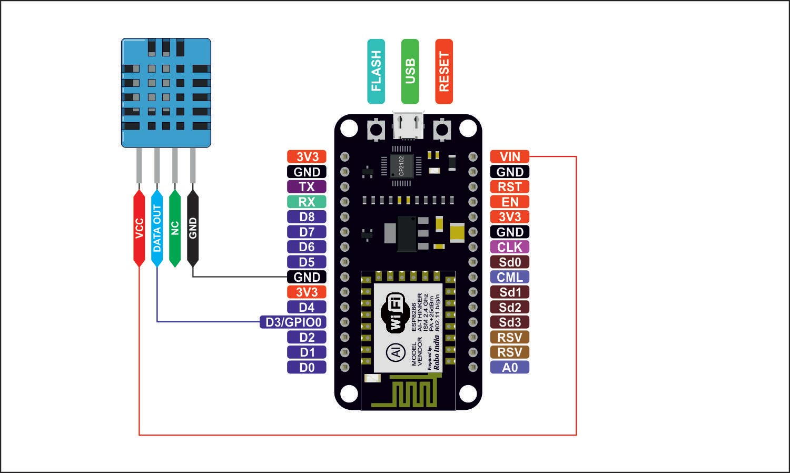
CIRCUIT LAYOUT

Slide 6
CONCLUSION
The data obtained can produce intelligent information for decision making.
The sensor will continuously sends real time data to central database that can be used later for various purposes.
The information of critical location like server room can be obtained conveniently through gadget.

